Slide 1
Lecture 1: Introduction
Profs. Austin & Theising
Environmental Economics Econ 4075

Slide 2
What is this class about?

Slide 3
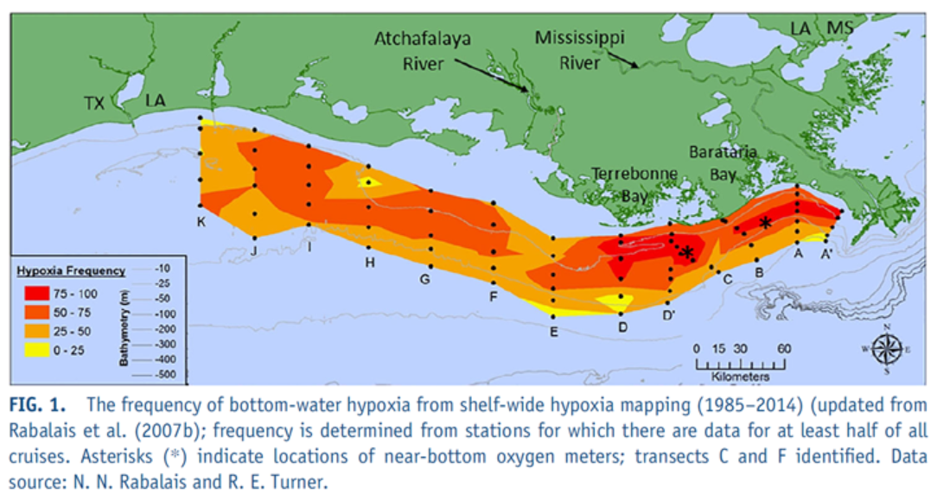
Question 1: Why and when do environmental problems occur?
Ex: What causes the annual summer hypoxia “Dead Zone” in the Gulf of Mexico?
Ecological impacts on marine habitats →
Lost commercial seafood revenues
Potential for regional fishery collapses
Lost tourism
Source: https://www.epa.gov/ms-htf/northern-gulf-mexico-hypoxic-zone

Slide 4
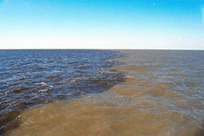
Question 1: Why and when do environmental problems occur?
Ex: What causes the annual summer hypoxia “Dead Zone” in the Gulf of Mexico?
Ecological impacts on marine habitats →
Lost commercial seafood revenues
Potential for regional fishery collapses
Lost tourism
Source: https://www.nasa.gov/vision/earth/environment/dead_zone.html
Source: https://www.epa.gov/ms-htf/northern-gulf-mexico-hypoxic-zone

Slide 5
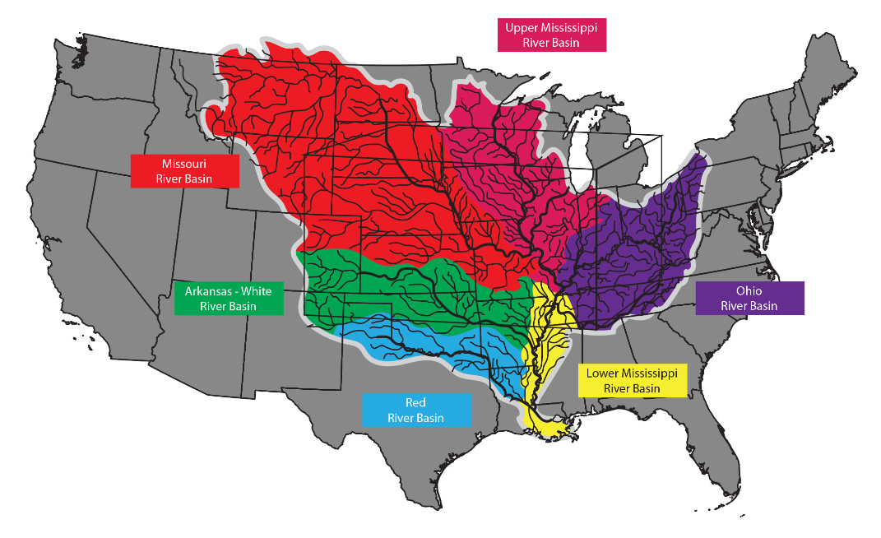
Question 1: Why and when do environmental problems occur?
Major concepts: market failure, externalities, economic efficiency, property rights, environmental policies
Environmental issues: water pollution, air pollution, toxic chemical use, hazardous waste management, climate change…
Source: https://www.lsuagcenter.com/profiles/lbenedict/articles/page1515431998585

Slide 6
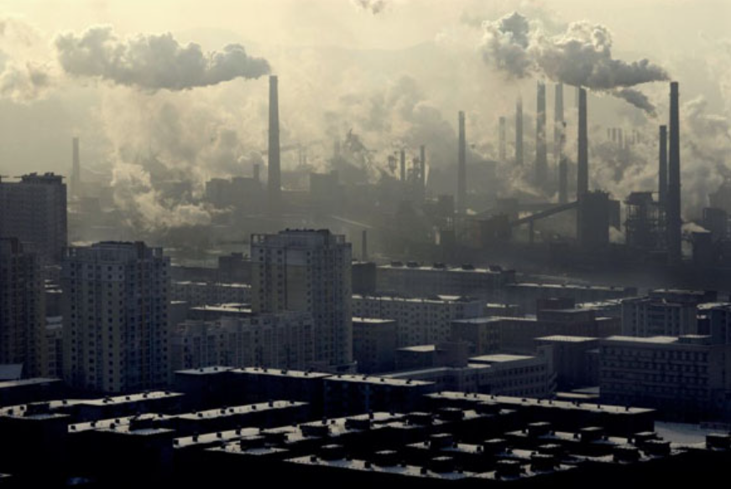
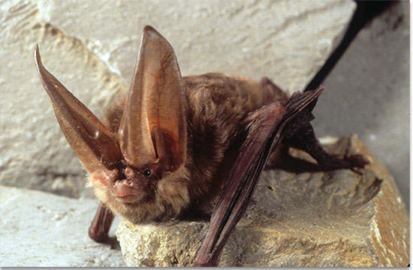
Question 2: How much environmental damage should society allow?
Ex: how much of a toxic chemical should we allow to be released via air or water?
Ex: should we save the Virginia big-eared bat from extinction?
Major concepts: nonmarket valuation, cost-benefit and regulatory analysis, discounting, efficiency versus equity, environmental justice
Source: https://environmentlawhistory.blogspot.com/2015/09/air-pollution-law-before-clean-air-act.html
Source: https://fw.ky.gov/Wildlife/Pages/Virginia-Big-Eared-Bat.aspx

Slide 7
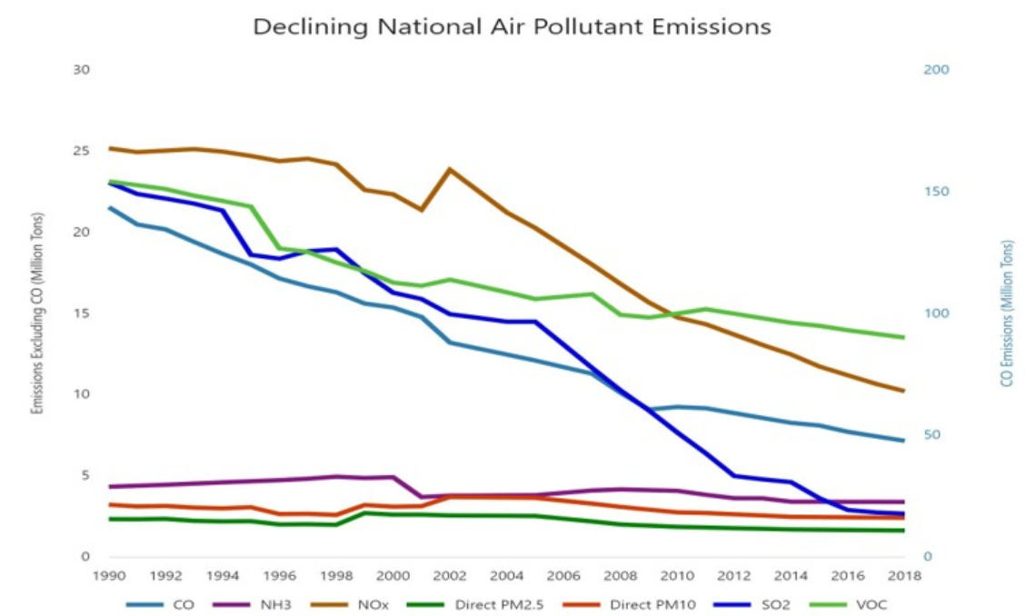
Question 3: How has US environmental policy leveraged economic insights to reduce pollution?
Major concepts: pollution monitoring, information provision, liability, Pigouvian taxes, cap-and-trade systems, emissions standards, and many more…
An overview and discussion of successes and failures from: the CAA, CWA, SDWA, TSCA, CERCLA, RCRA…
Source: https://www.epa.gov/clean-air-act-overview

Slide 8
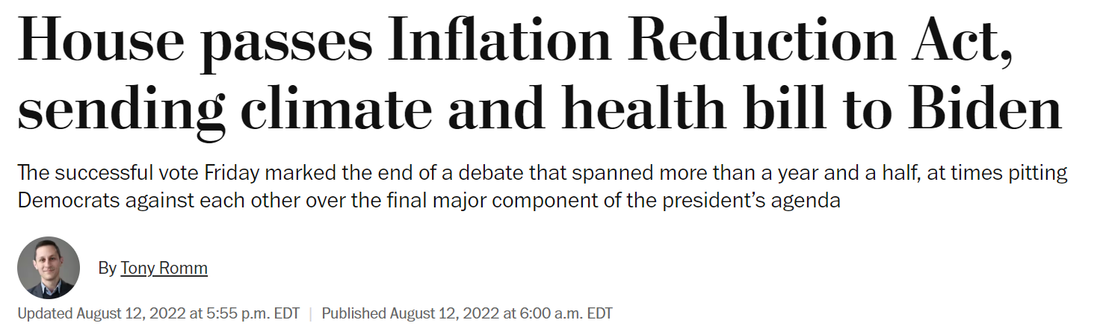
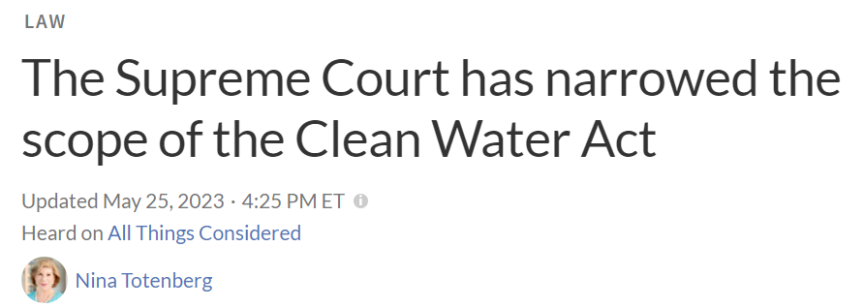
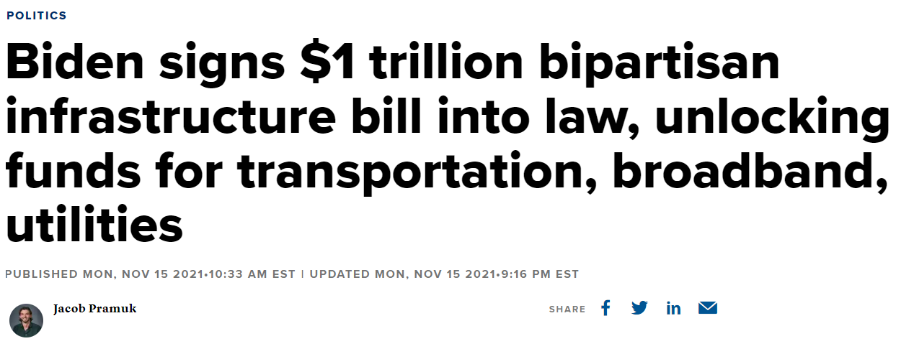
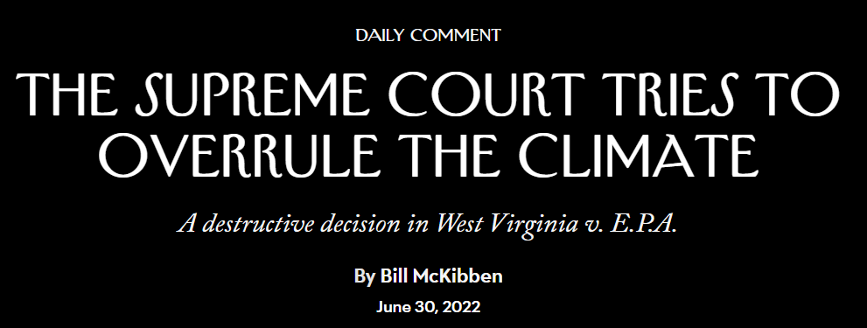
Question 4: What are environmental economists working on now?

Slide 9
Overview
Motivating Question: | Module: | Lecture #s:
Q1: Why and when do environmental problems occur? | 1: Market Failure and the need for Environmental Regulation | 2 – 3
Q2: How much environmental damage should society allow? | 2. Measuring Environmental Benefits | 4 – 10
 | 3. Environmental Regulatory Impact Analysis | 11 – 14
Q3: How has US environmental policy leveraged economic insights to reduce pollution? | 4. Economics and Environmental Policy | 15 – 21
Q4: What are environmental economists working on now? | 5. International Environmental Economics and Policy Frontiers | 22 – 23

Slide 10
Course objective:
In one sentence: you should leave this class with a rigorous economic framework for evaluating environmental issues.
The course should provide you with the following (high-level) understanding of economists’ thinking on the environment:
Economists do not believe that the free market solves all environmental problems
Environmental goods and services have economic value, even if they’re not traded in a market.
All decisions concerning environmental policy involve trade-offs.

Slide 11
Logistics
Course materials (lecture notes, case studies) will be available here:
https://github.com/adamtheising/environmental_economics
TA for the course: Yagmur Menzilcioglu (ym406@georgetown.edu)
We’ll send any class announcements via email
We welcome questions by email; please follow up if no response within 2 days
Office hours: via Zoom/Teams, by appointment
Grading:
Reflection posts and case studies (30%)
Exams: Midterm (Oct. 18, 35%) and Final exam (Dec. 4, 35%)
See syllabus for grade scale

Slide 12
About us:

Slide 13
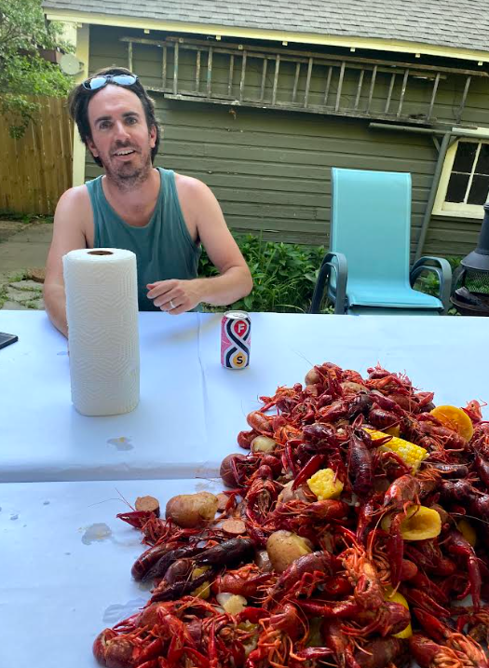

About Prof. Theising
Professional-wise:
At EPA since April 2021
Contributions on economics for water regs (WOTUS)
Economics and EJ analysis on TSCA chemical regs (lead paint, asbestos, 1,4 dioxane, & more)
Research focus on assessing nonmarket benefits of air + water quality, climate, and avoided health outcomes
Outside the office:

Slide 14
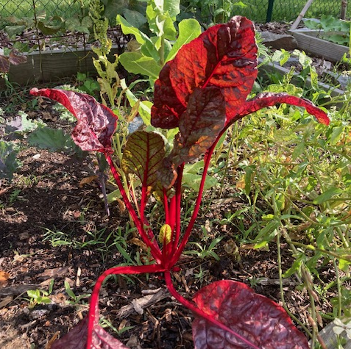

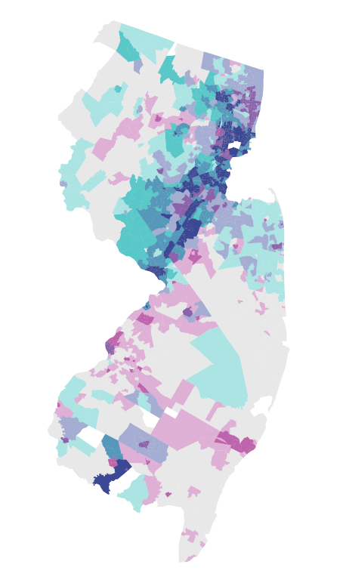
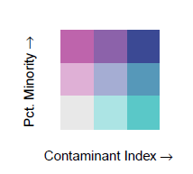

About Prof. Austin
Outside the office:
Professional-wise:
At EPA since August 2020
Contributions on SDWA, CWA, RCRA, and TSCA regulations (esp., PFAS)
Drinking water data development
Research focus on health implications of pollution exposure (e.g., school buses, coal ash, PM 2.5)
Figure: Drinking Water Contaminant Index and % Minority in New Jersey

